Slide 1

The Truth

Slide 2


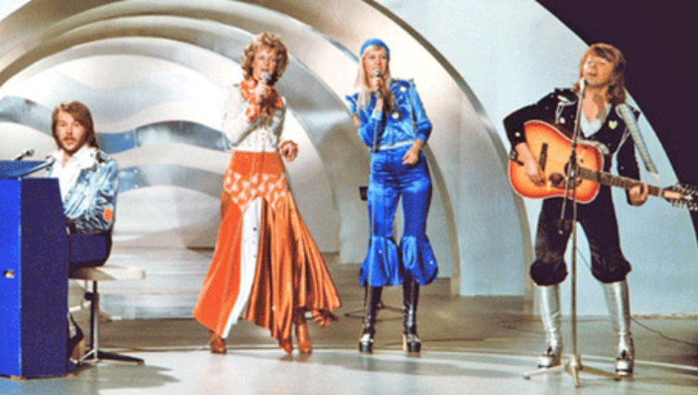
The Facts
Big 5
France
Germany
Italy
Spain
United Kingdom
Biggest Winners
Ireland (7)
Sweden (6)
Luxembourg (5)
France (5)
United Kingdon (5)
2019 Figures
182 million viewers
40 countries
United Kingdom gave zero points to ABBA in 1974.

Slide 3
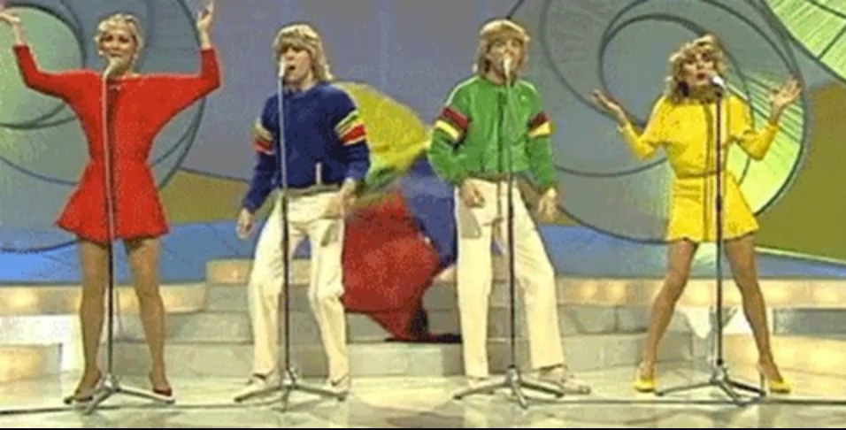
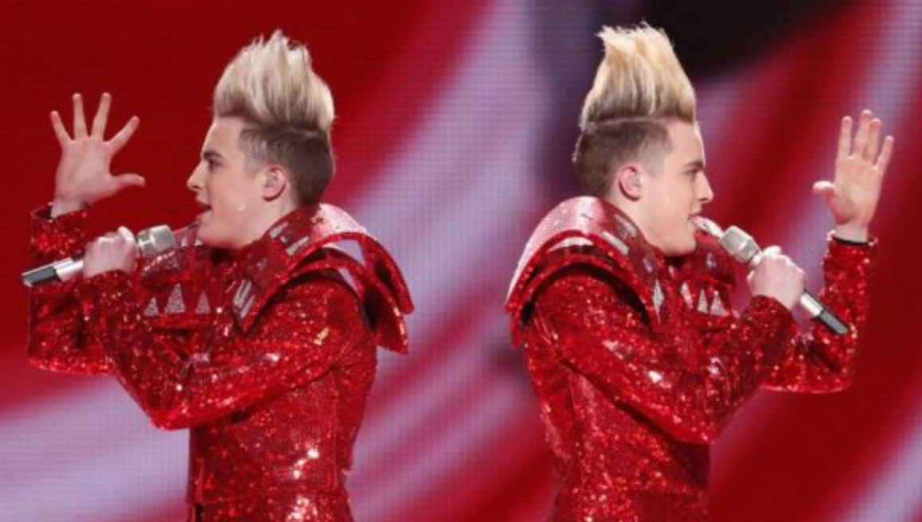
In 2019 United Kingdom finished last, but why?
« Europe hates us because of Brexit »
« It’s all political »
« WHAT’S THE POINT IN SENDING ANYONE, EUROPE HATES US »

Slide 4
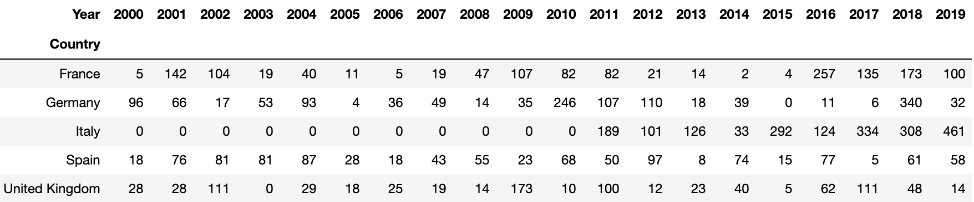
Is it really because of Brexit?

Slide 5
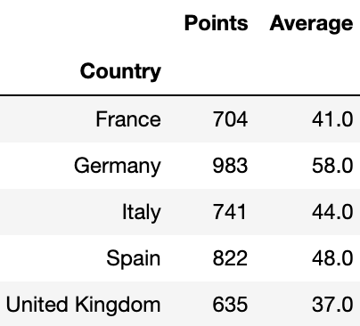
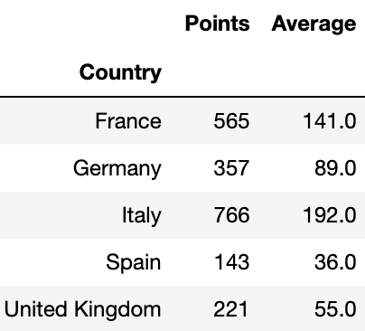
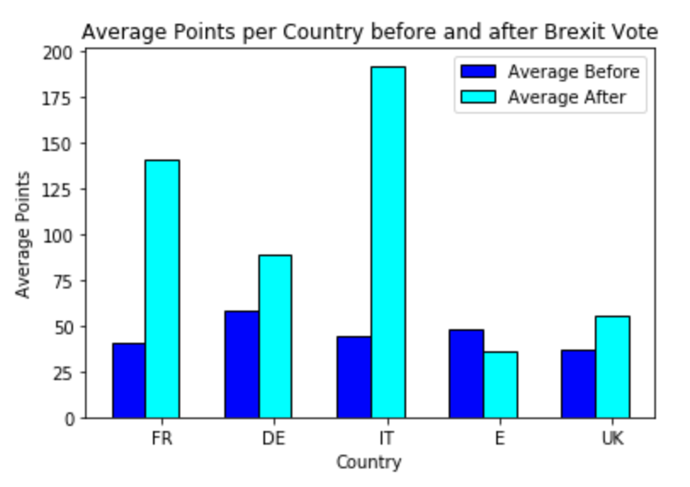
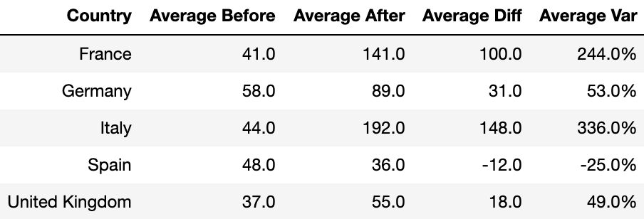
Votes pre-Brexit referendum 2016
Votes post-Brexit referendum 2016
* Jury/viewer vote introduced 2016

Slide 6
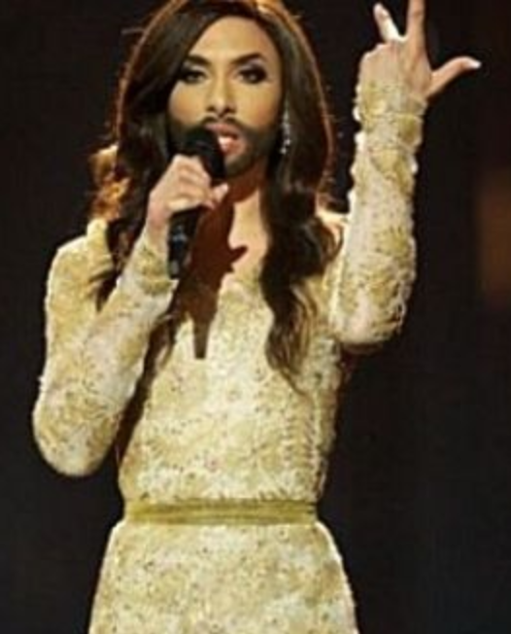

If it’s not Brexit, then what is it?

Slide 7
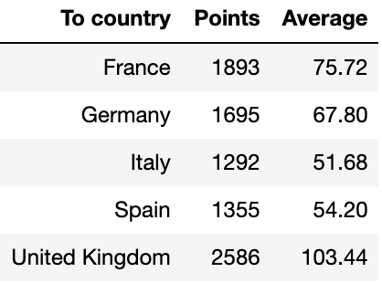
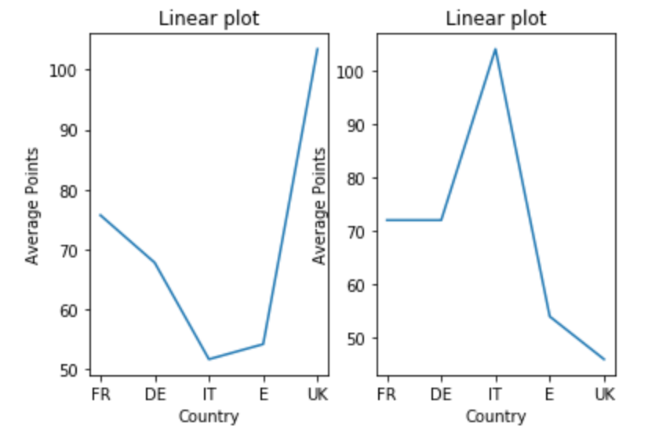
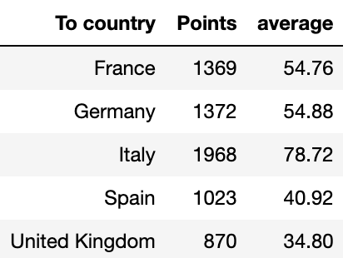
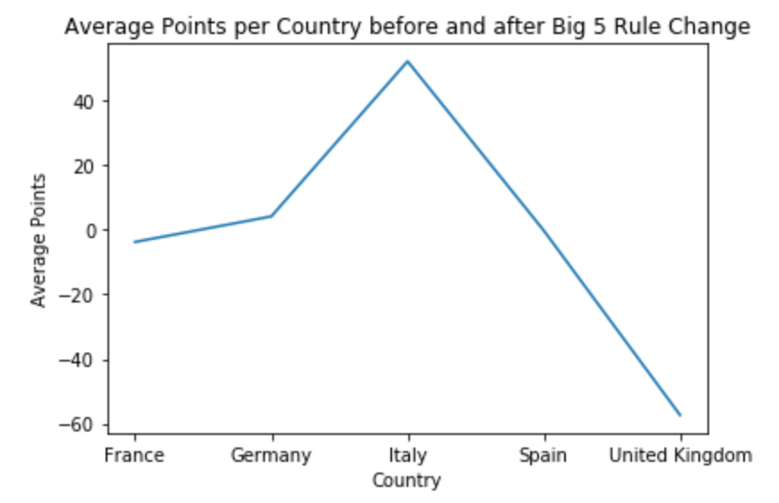
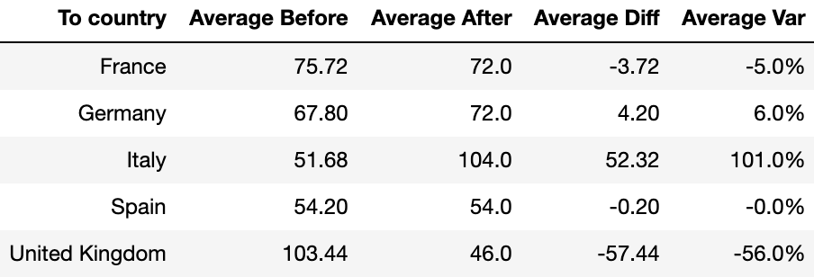
Big 5 before 2000 rule change
Big 5 after 2000 rule change

Slide 8
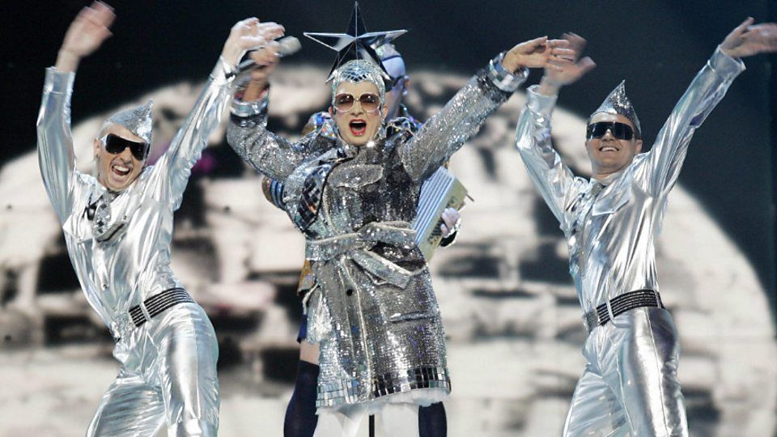

Is it the Big 5 rule?
Maybe.
But then why only France & United Kingdom have done worse?
Are we just not liked?

Slide 9
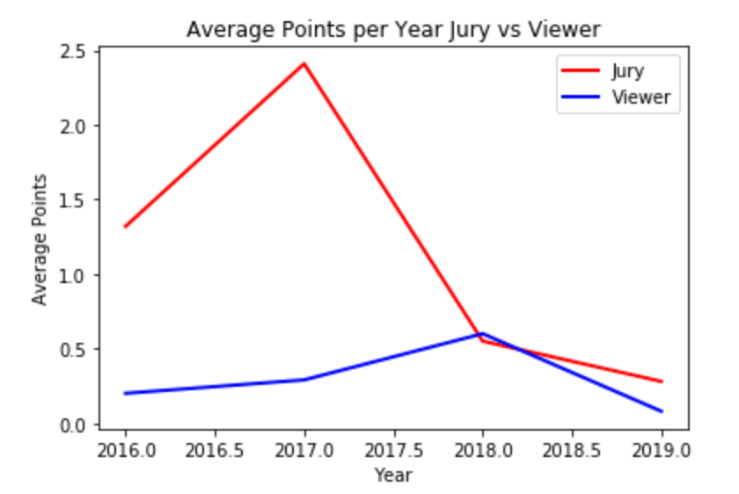
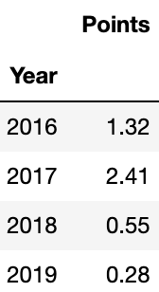
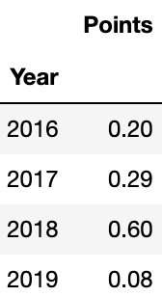
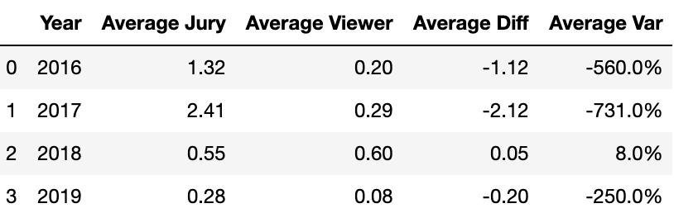
The Jury’s vote
The Viewer’s vote

Slide 10
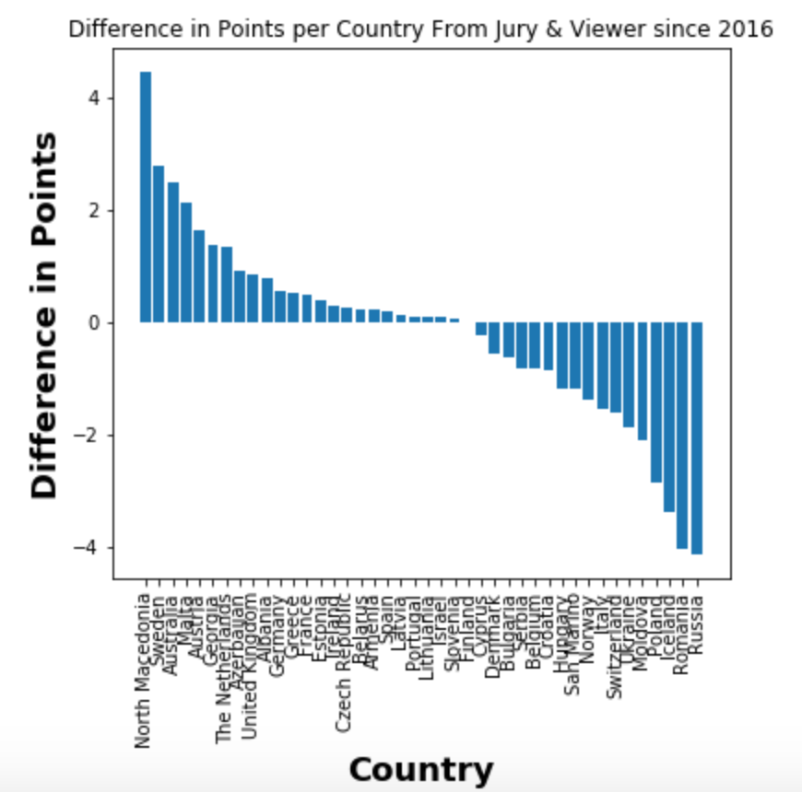

Slide 11
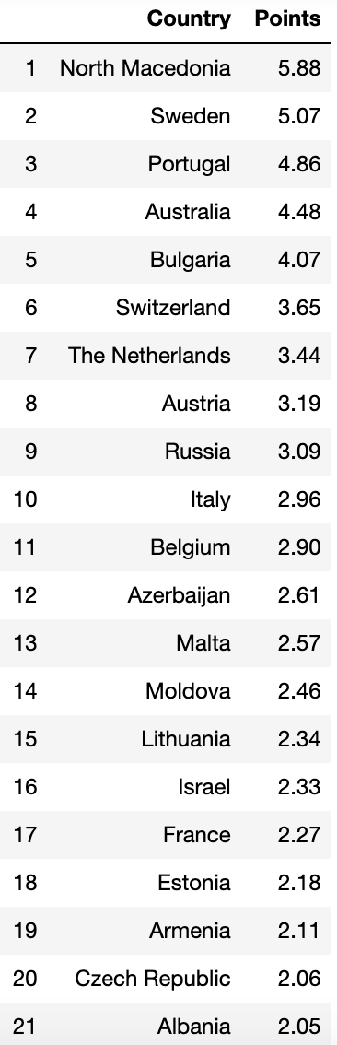
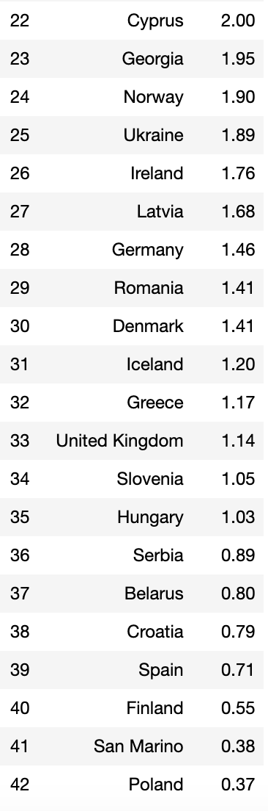
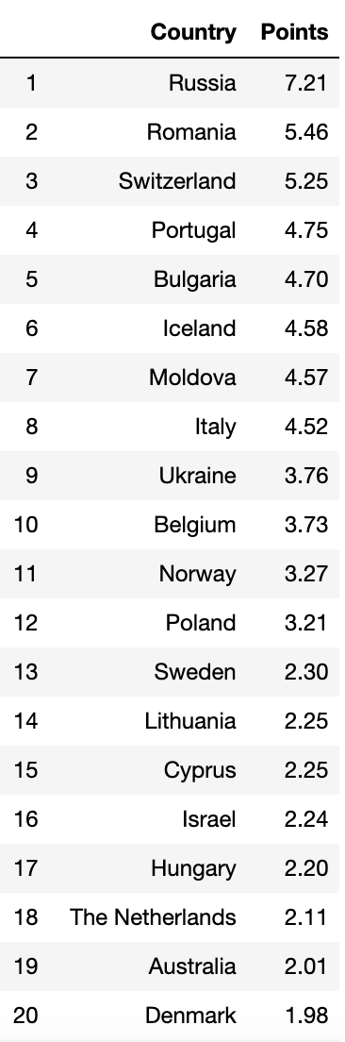
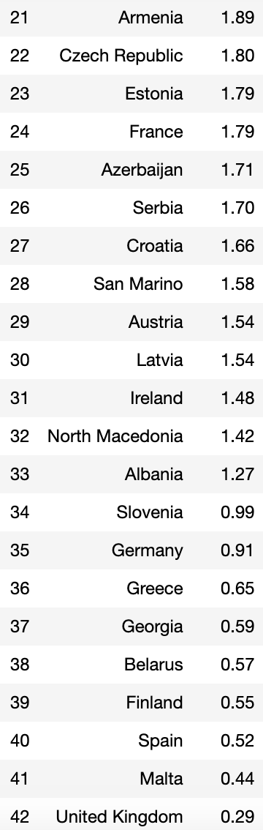
Average jury vote by country since 2016
Average viewer vote by country since 2016

Slide 12

Conclusion
Votes have actually improved since the Brexit referendum
Votes have declined since the Big 5 rule was introduced but only for UK & France
The viewers’ votes have been poorer than the jurors’
The average jury vote for UK is 3rd to last
We just need a good song with a good performance

